Slide 1

Laptop Price Prediction for SmartTech Co.
In this data science capstone project, we developed a robust machine learning model to accurately predict laptop prices. Our goal was to provide SmartTech Co. with valuable insights into pricing strategies, feature importance, and brand influence to enhance their competitiveness in the dynamic laptop market.
ja
by Janaki G

Slide 2

Project Overview
1
Objective
2
Key Goals
Develop a reliable machine learning model to accurately predict laptop prices.
Understand feature impact on pricing, assess brand influence, and provide strategic pricing recommendations.

Slide 3
Client's Objectives
Accurate Pricing
Market Positioning
Brand Influence
Enhance competitiveness in the laptop market by optimizing pricing strategies.
Gain insights into how product features influence consumer demand and pricing.
Understand the impact of brand perception on laptop prices and customer preferences.

Slide 4

Key Challenges
Diverse Specifications
Real-time Prediction
The dataset encompassed laptops with a wide range of technical specifications, requiring a robust modeling approach.
Developing a model that can provide accurate, real-time price predictions for new laptop configurations.
Model Interpretability
Ensuring the model's insights are transparent and actionable for business decision-making.

Slide 5
Data Exploration
Dataset Overview
Feature Relationships
The dataset contained information on over 1,303 laptops, including key features such as price, Type, RAM, processor speed, and brand.
Exploring the correlations between features and price provided valuable insights into key drivers of laptop pricing.
1
2
3
Price Distribution
Initial analysis revealed a wide range of laptop prices, with a skewed distribution towards the lower end.

Slide 6
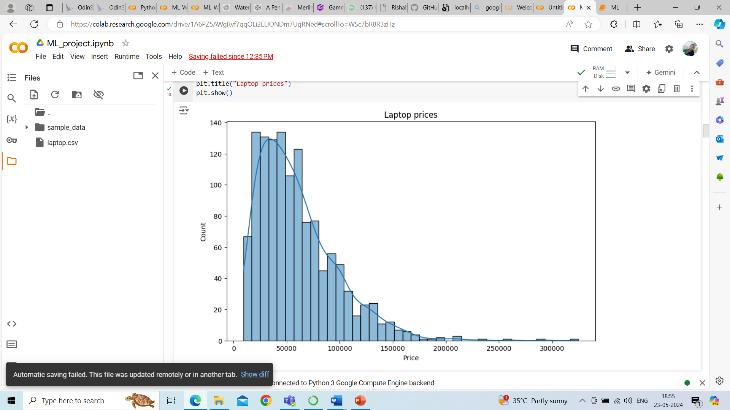
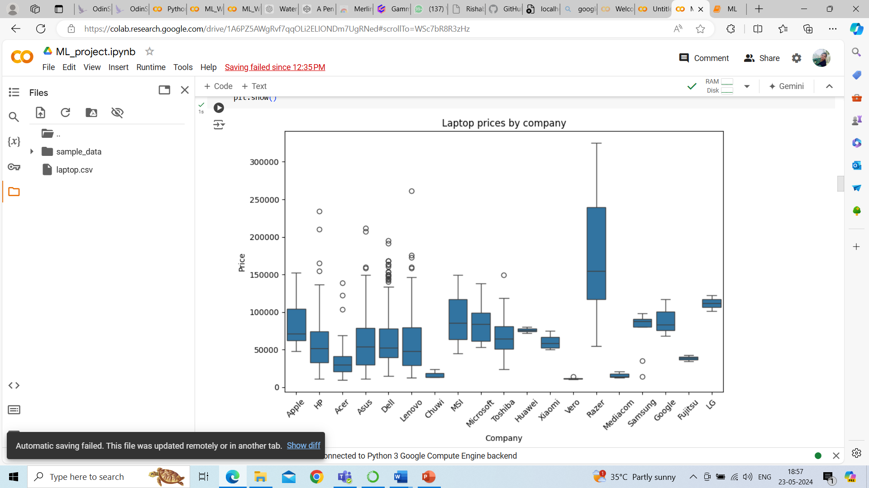
Data Visualization
Price vs. Brand
Price Distribution
The box plot highlighted the significant influence of brand on laptop pricing, with some brands commanding higher prices.
The histogram showcased the wide range and skewed nature of laptop prices in the dataset.

Slide 7
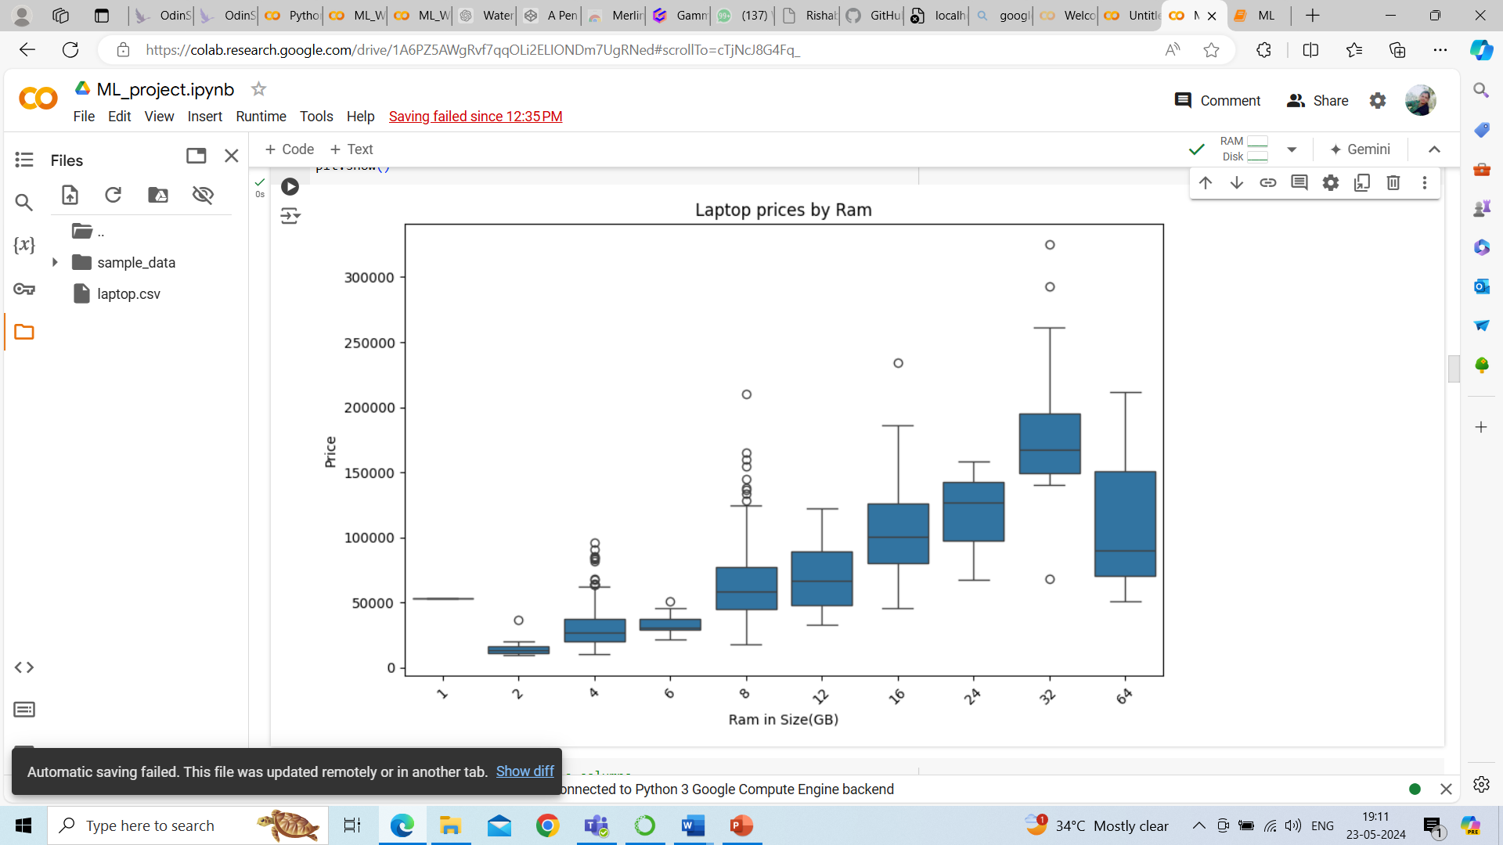
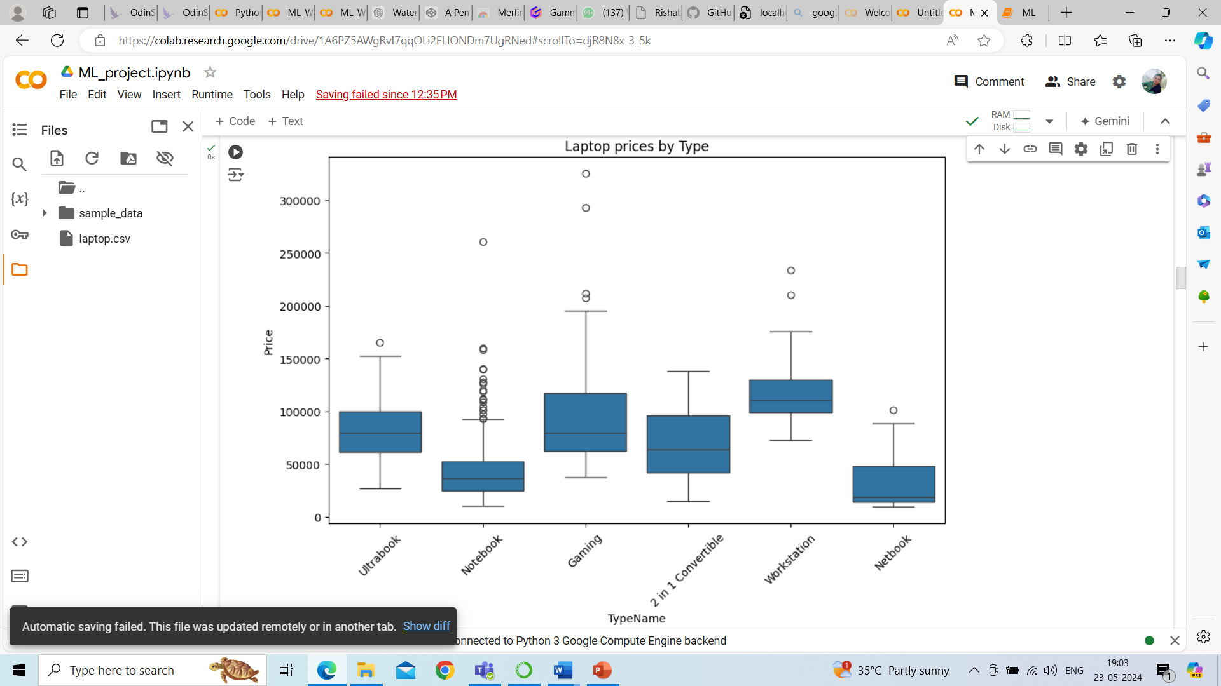
Data Visualization
Price Vs Type
Price vs. RAM
The box plot highlighted the significant influence of type on laptop pricing, with some types commanding higher prices
The box plot revealed a positive correlation between laptop RAM and price, indicating RAM as a key pricing factor.

Slide 8


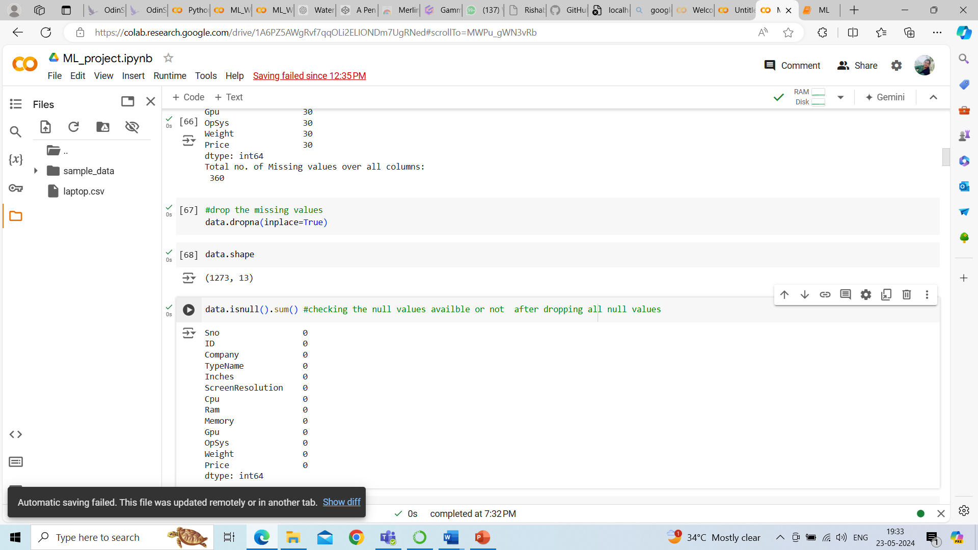
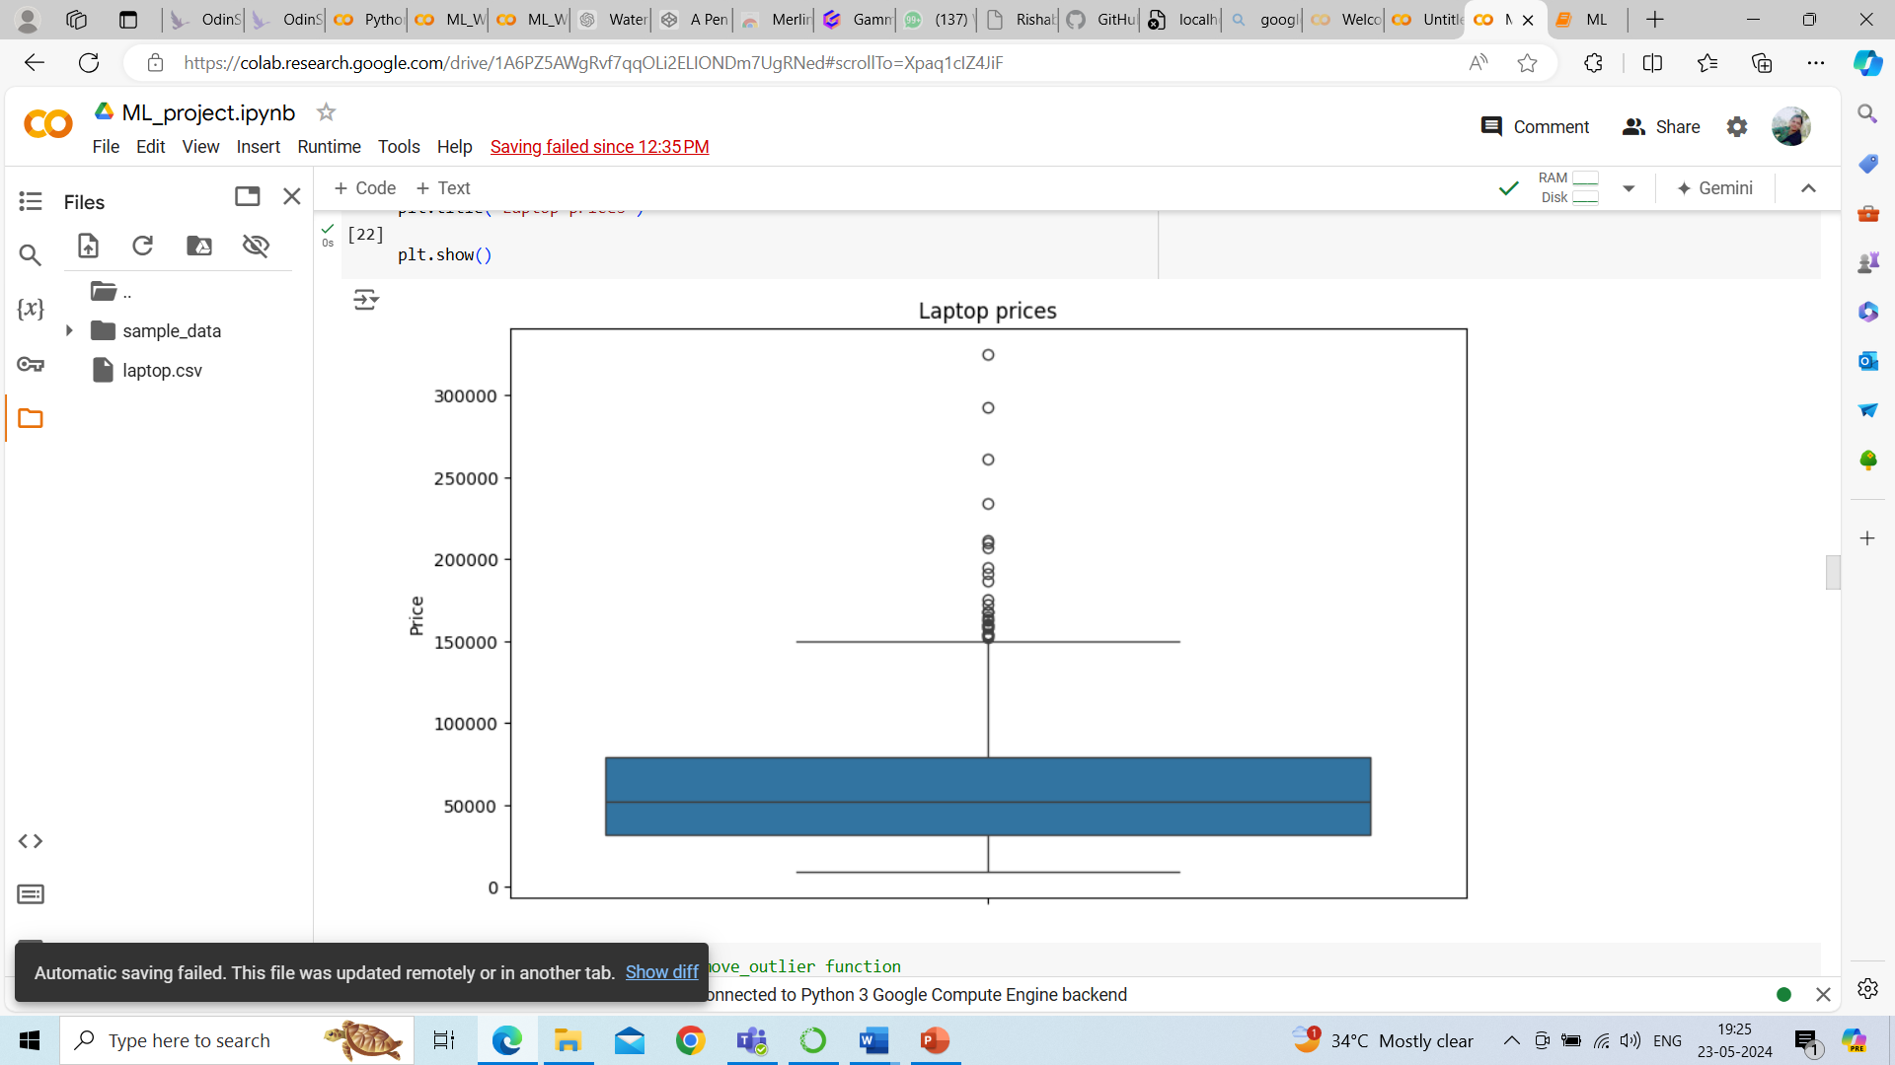
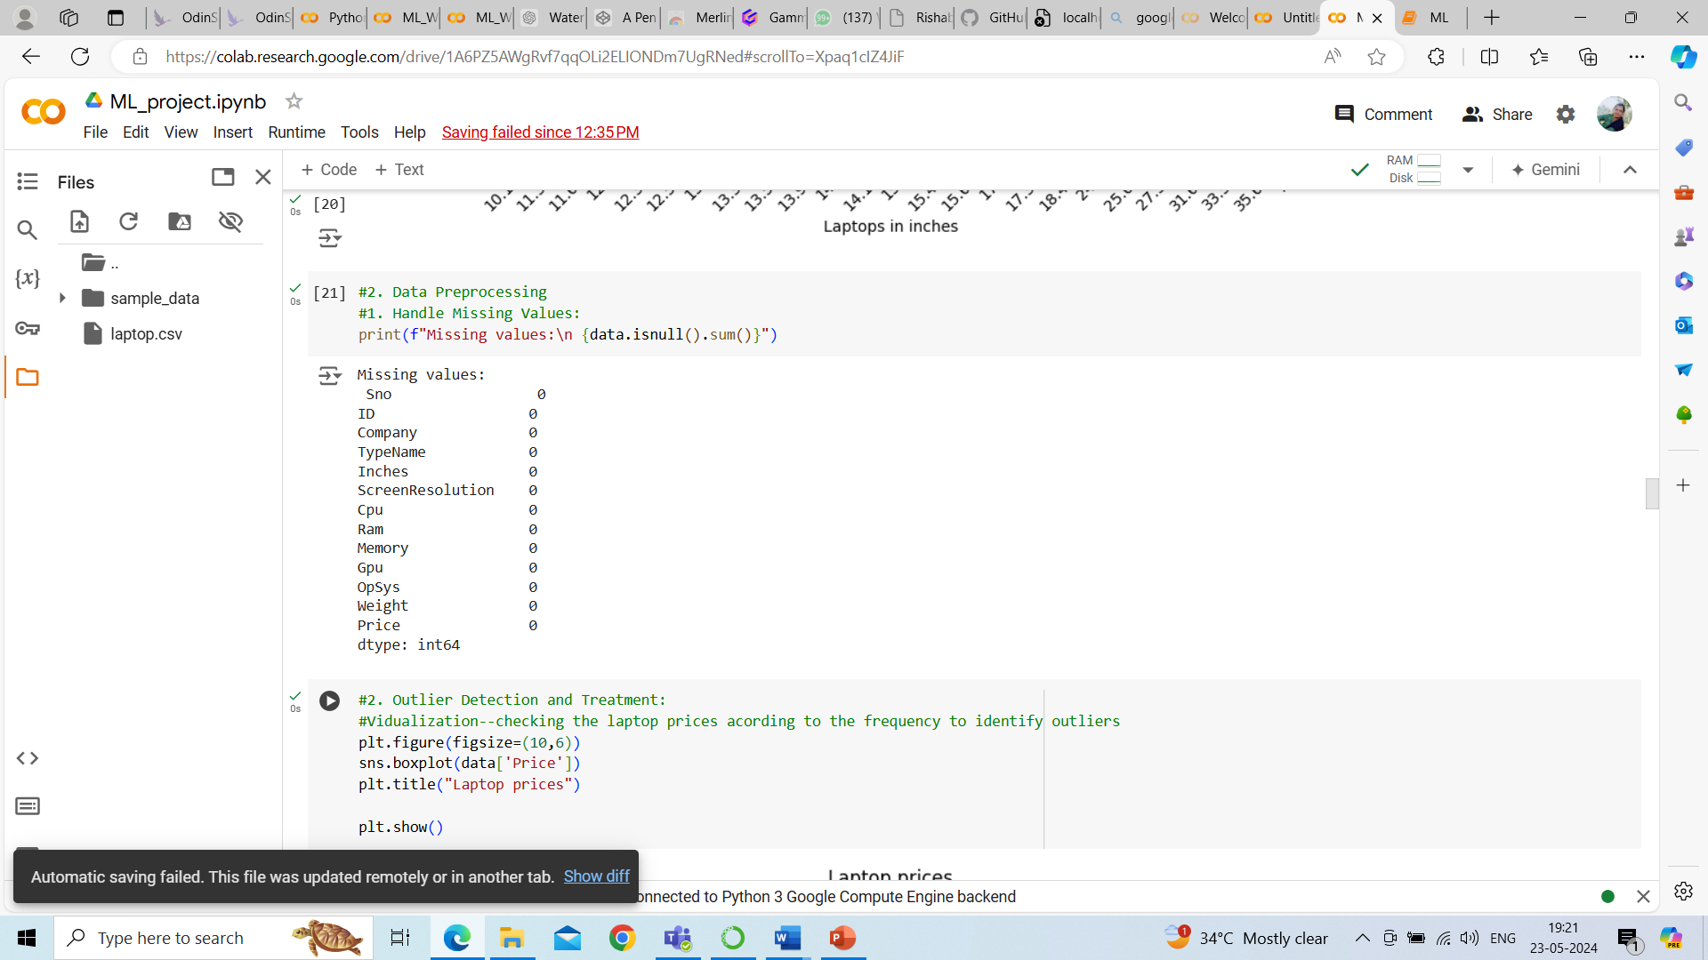
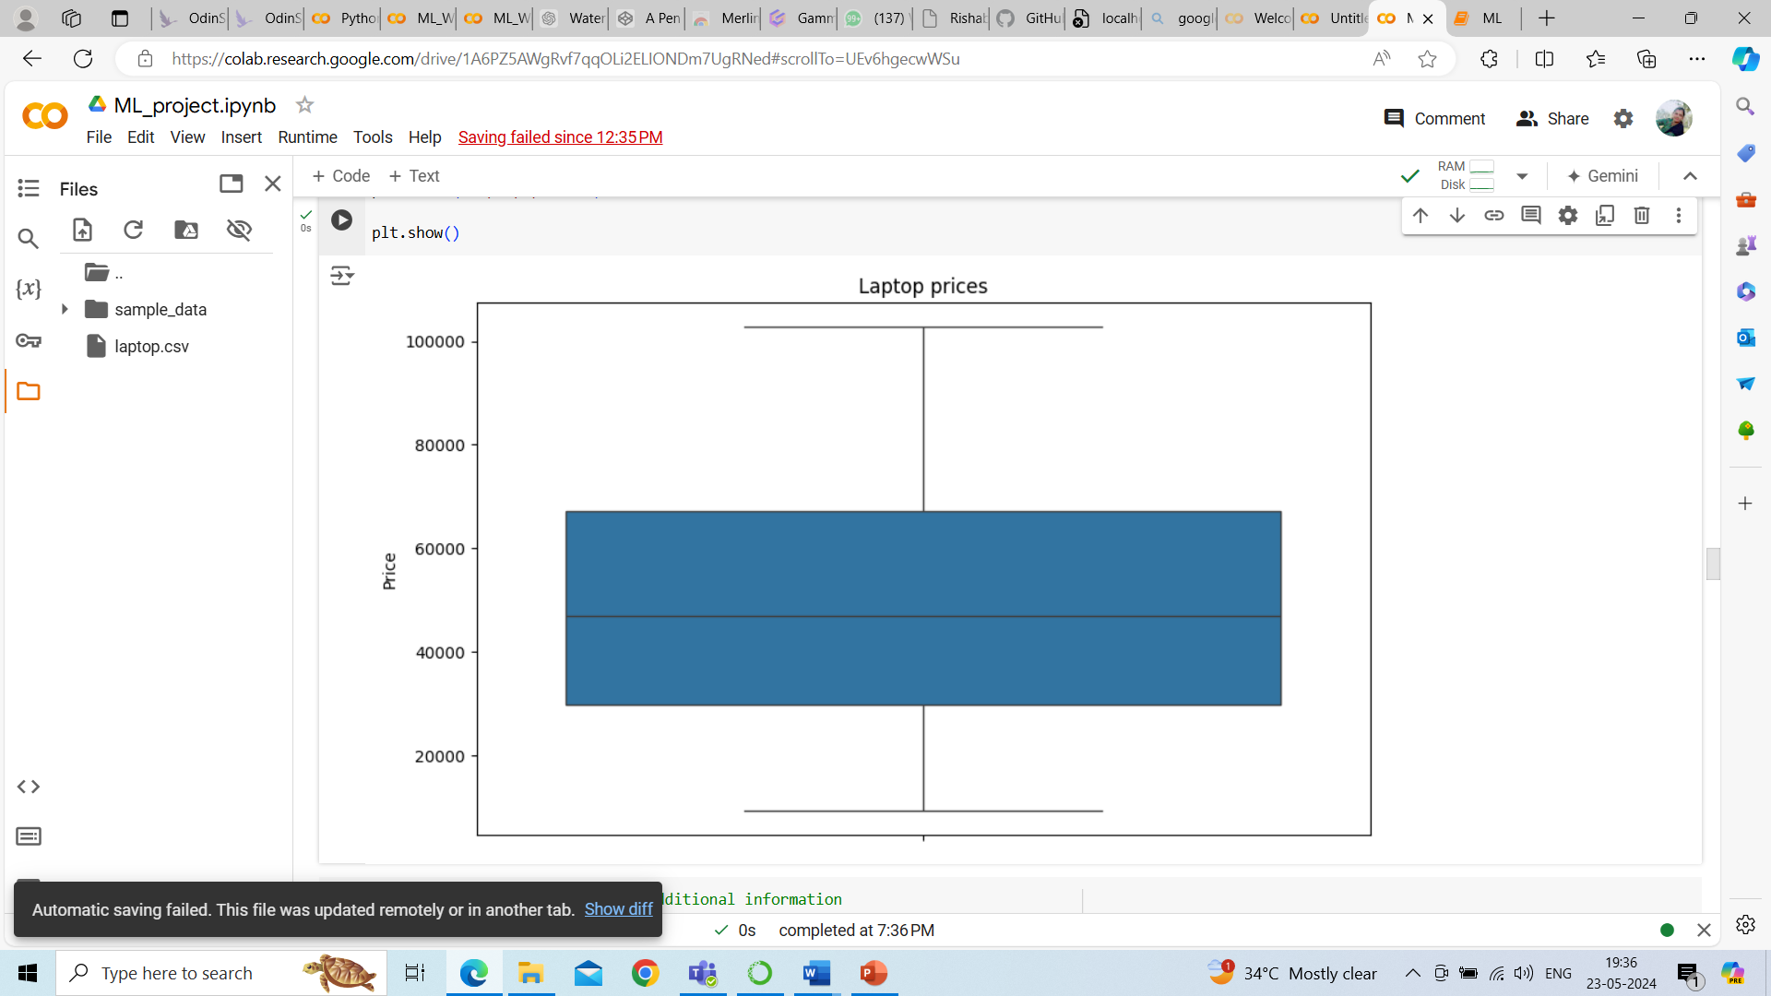
Data Preprocessing
Missing Values
Outlier Removal
Handled missing data through a combination of dropping and imputing techniques.
Identified and removed outliers using the IQR
method to ensure data integrity.
Before outliers
After outliers removed
1303x13
1120x13

Slide 9


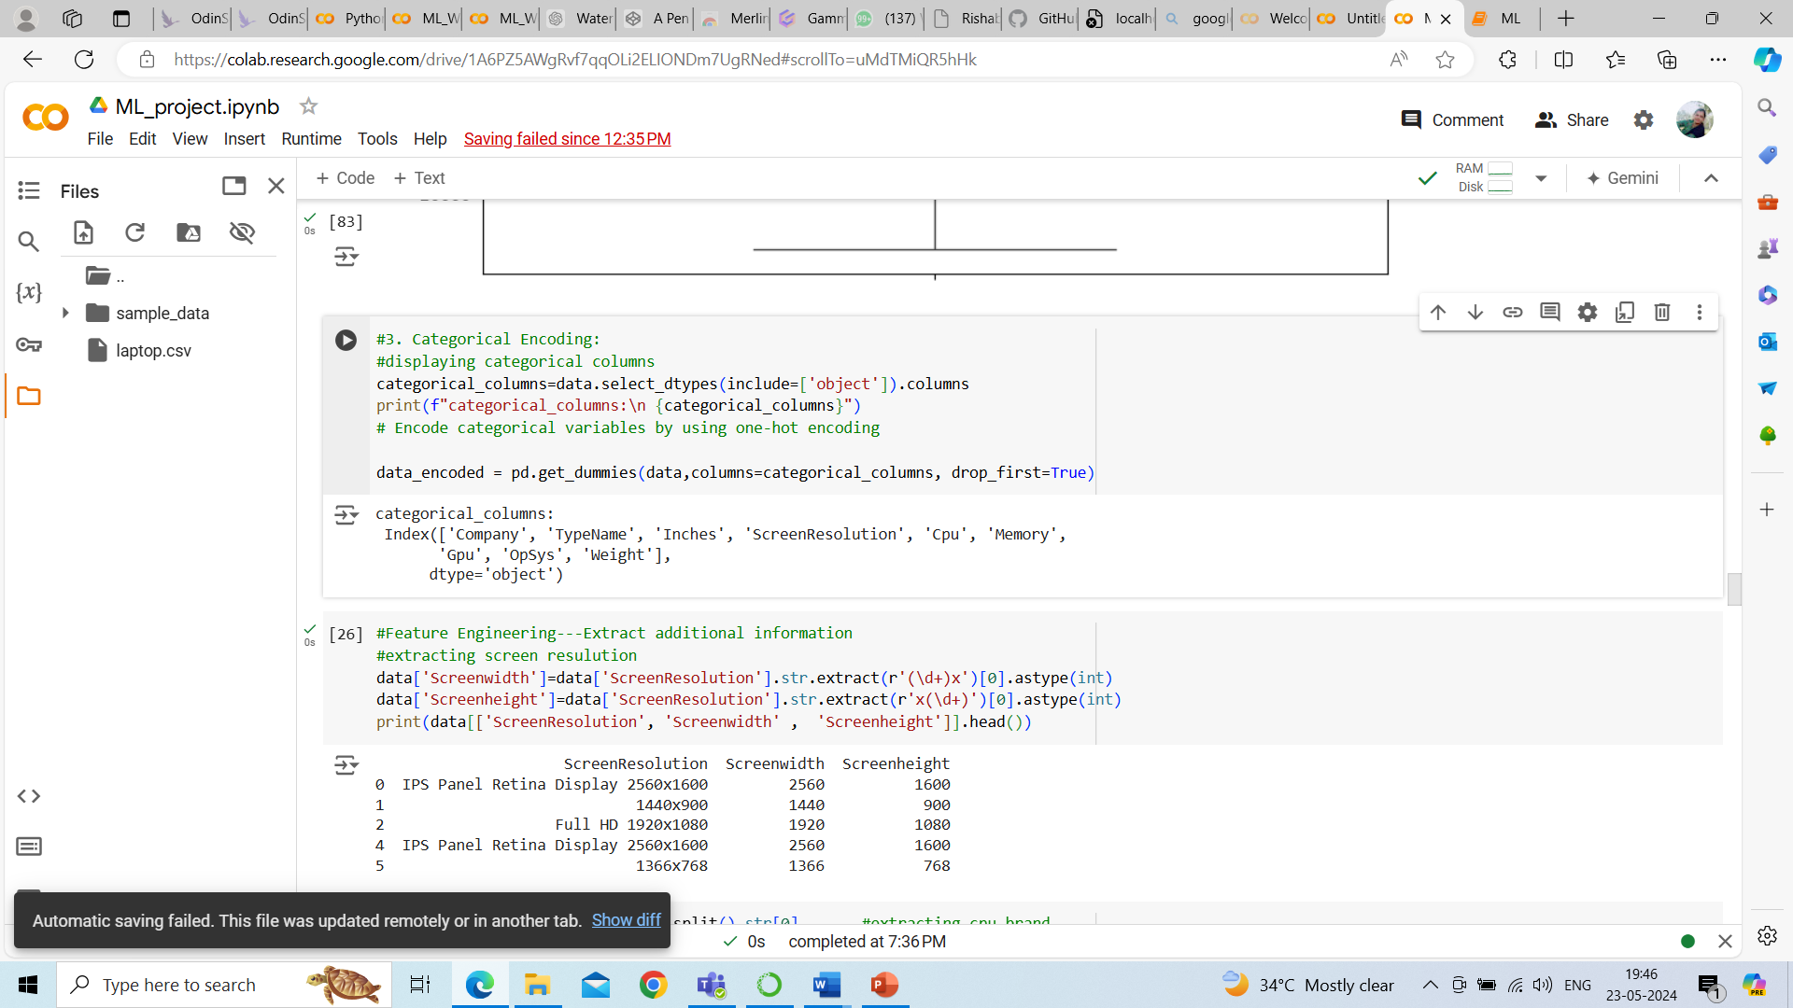
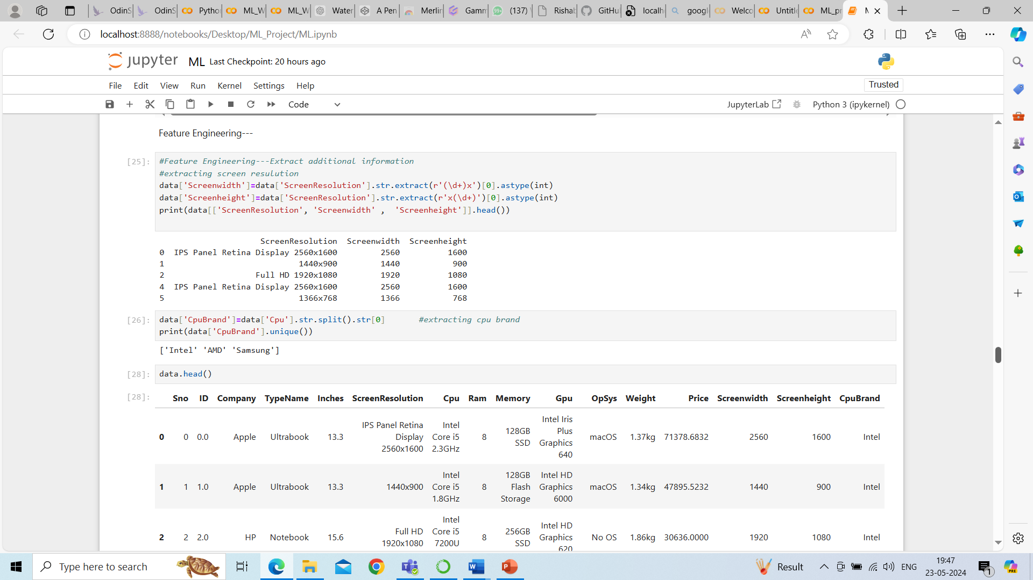
Data Preprocessing
Categorical Encoding
Feature Scaling
Converted categorical variables into numerical representations using one-hot encoding.
Standardized the numerical features to ensure equal weight in the modeling process.

Slide 10
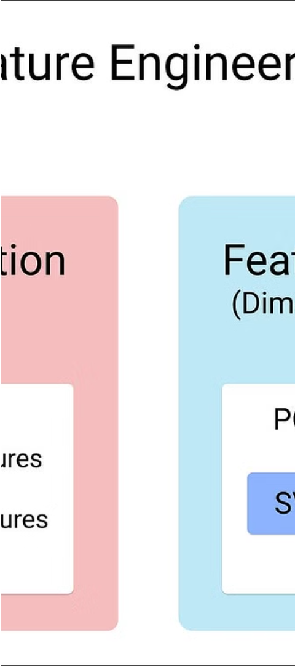



Feature Engineering
New Features
Created a custom feature as Inches, ScreenHeight and Screenwidth, significantly affect the price of a laptop. Larger and higher-resolution screens are associated with higher costs due to increased manufacturing expenses and the inclusion of additional premium features.
Feature Selection
Used Random Forest feature importance to identify the most influential factors driving laptop prices.
Top Features
The top features selected were RAM, processor speed, brand, screen size, and storage capacity.

Slide 11
Model Development
Algorithms Used
Evaluation Metrics
Tuning
We evaluated the performance of three machine learning models: Linear Regression, Random Forest, and Gradient Boosting.
To assess the models, we used MSE (Mean Squared Error) and R² (R-squared) as the key performance metrics.
For the Random Forest and Gradient Boosting models, we performed hyperparameter tuning to optimize their performance.

Slide 12
Model Development
Algorithm
MSE
R-squared
Linear Regression
162804248.00
0.7369
Random Forest
125480808.74
0.7935
Gradient Boosting
120069799.67
0.8032
After evaluating multiple machine learning algorithms, the Gradient Boosting model emerged as the best performer, with the lowest MSE and highest R-squared.

Slide 13
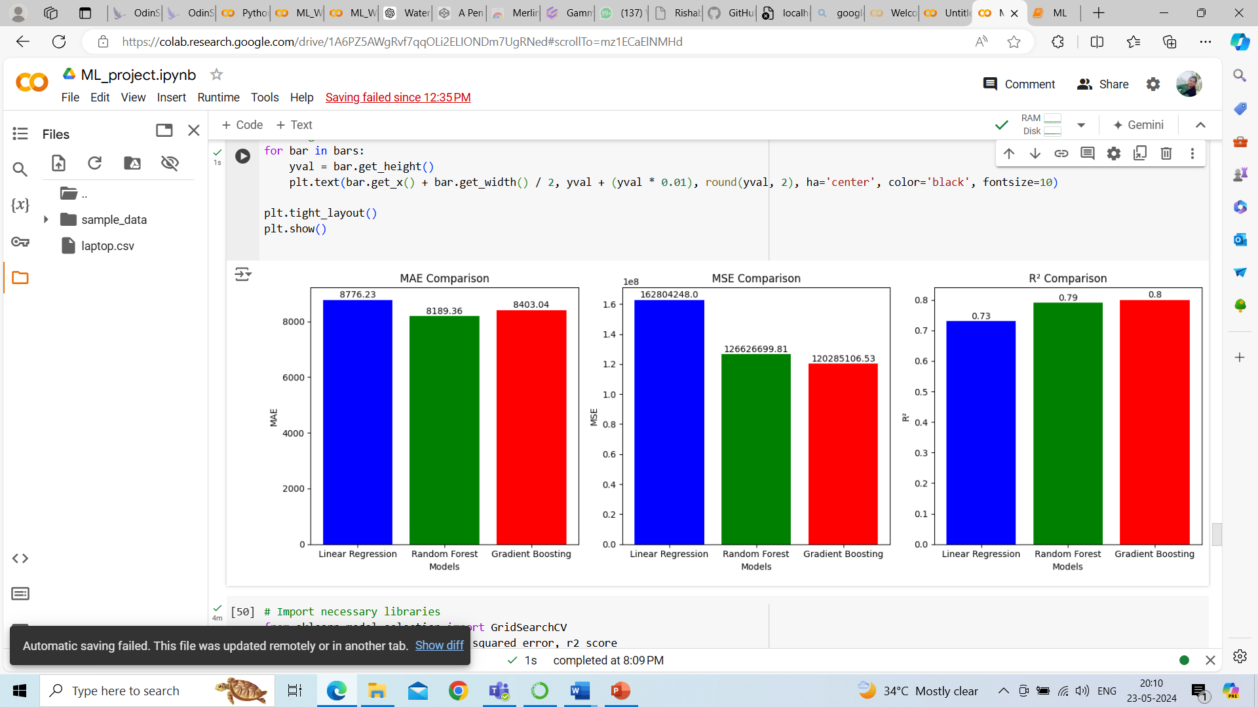
Comparison of MSE and R2 Score with different models before hypermeter tuning

Slide 14
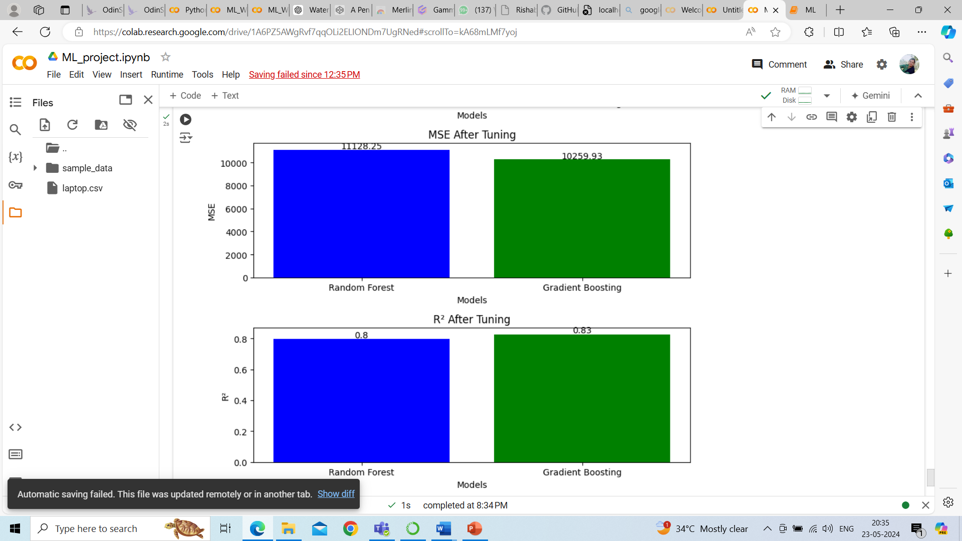

Slide 15
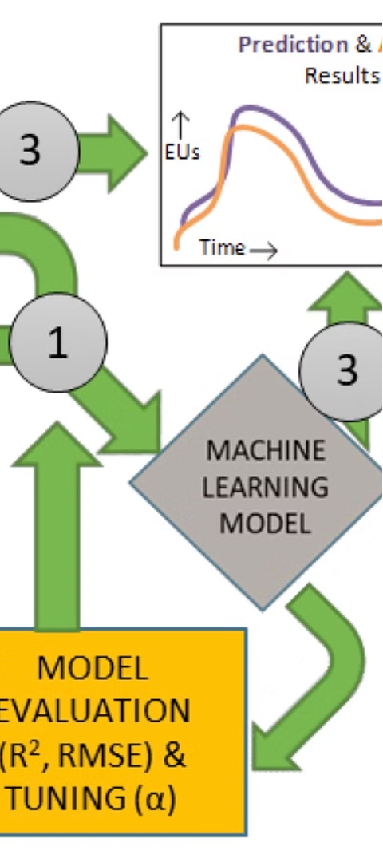
Model Performance
1
Comparison of Models
The Gradient Boosting model outperformed the other algorithms, achieving an MSE of 120069799.67 and an R² of 0.8032
2
Best Model
Based on the evaluation metrics, the Gradient Boosting model was selected as the best-performing model for predicting laptop prices.
3
Hyperparameter Tuning
The tuned Gradient Boosting model had the following optimal parameters: MSE of 10259.93 and an R² of 0.83 further improving its performance.

Slide 16
Insights and Recommendations
1
Feature Impact
2
Brand Influence
3
Market Strategy
The top features influencing laptop prices were processor speed, RAM, and brand. Optimizing these factors can significantly impact pricing strategies.
Our analysis revealed that brand plays a substantial role in pricing, with some premium brands commanding higher prices. Leveraging this insight can help SmartTech Co. position their products more effectively.
Based on the model's findings, we recommend that SmartTech Co. focus on enhancing their product specifications, particularly in terms of processor performance and memory, to remain competitive. Additionally, they should consider building a stronger brand identity to capitalize on the premium pricing opportunities.

Slide 17
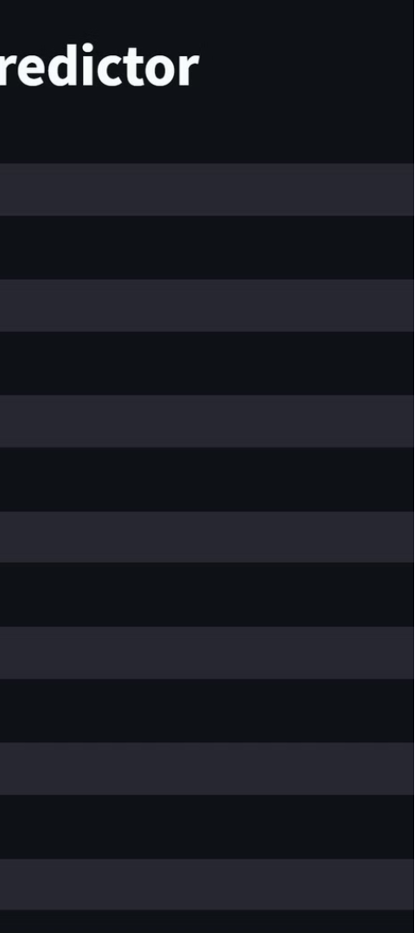



Conclusion
Accurate Pricing
The Gradient Boosting model developed can provide precise price predictions, enabling SmartTech Co. to make informed decisions and remain competitive.
Feature Insights
The analysis of feature impact on pricing provides valuable guidance for product development and strategic positioning.
Brand Influence
The assessment of brand perception's influence on pricing will help SmartTech Co. develop effective marketing strategies.

Slide 18
Thank You

